Slide 1
Rapid Response
Services and Resources
Notes:
Revised September 16, 2021

Slide 2
Purpose
Provide information on unemployment benefits and programs.
Discuss employment and training assistance programs.
Connect to other federal, state, and local resources.
Notes:
Rapid Response is a no cost program designed to get you back to work as quickly as possible following a layoff or plant closure. The purpose of this Rapid Response Orientation is to:
Provide information on the unemployment compensation benefits and programs,
Discuss employment and training programs available through the comprehensive one-stop delivery system, and
Connect you to other federal, state, and local resources.
These services and resources are customized to your needs, with the goal of minimizing the disruptions on your life associated with job loss. These services are carried out by state and local workforce development agencies in partnership with the America’s Job Center of CaliforniaSM network.

Slide 3
Unemployment Insurance Program
Partial income replacement for employees who lost their jobs or had hours reduced due to no fault of their own.
Funded by employers at no cost to employees.
Weekly benefit amounts range from $40 to $450 based on earnings.
Notes:
The Unemployment Insurance benefits program provides:
A partial, temporary income replacement for employees who have lost their jobs or have had their hours reduced due to no fault of their own.
Funded by employers at no cost to employees.
Regular Unemployment Insurance (UI) claim weekly benefit amounts range from $40 to $450 based on previous earnings. When filing for UI benefits, you must have earned enough wages during the base period to establish a claim. The UI base period is a specific 12-month term the EDD uses to see if you earned enough wages to establish a UI claim. The length of your claim depends on your wages.

Slide 4
Unemployment Improvements
UI OnlineSM is available to certify for benefits, check payment information, reopen an existing claim, and more.
EDD is improving its systems to verify identities, process claims, prevent fraud, and reduce the backlog of claims.
New unemployment claimants will need to verify their identity through ID.me before they can file a claim online.
Notes:
[READ SLIDE]

Slide 5
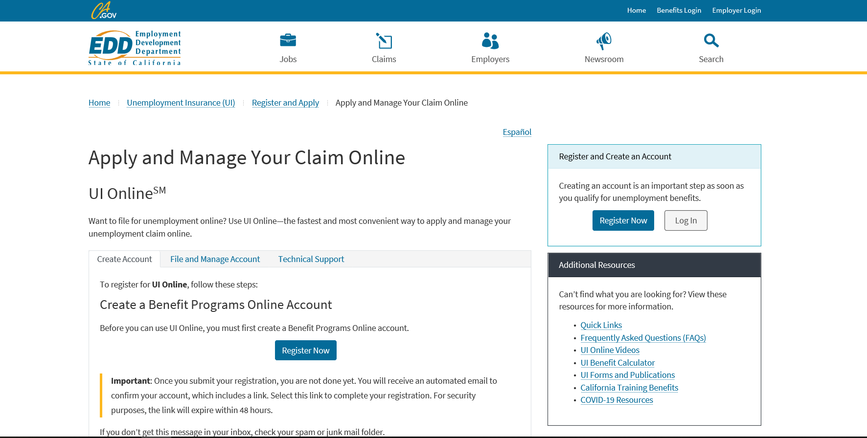
edd.ca.gov/UI_Online
Notes:
To apply for Unemployment insurance claims, you can file online, by phone, fax, or mail.
Online:
UI OnlineSM is the fastest way to file a claim at edd.ca.gov/UI_Online. The system is available 7 days a week, 24 hours a day.

Slide 6
Unemployment Insurance Basics: File a Claim
Online:
  Create a Benefit Programs Online login to access UI Online.
  Claimants may receive a confirmation email within a few days notifying them a UI Online account has been created for them.
  UI Online technical assistance is available daily from 8 a.m. to 8 p.m. to help with registration and password resets.
Phone:
  Speak to a representative to file a claim: 1-800-300-5616
Fax or Mail:
  Complete the paper application and submit as directed on the form.
    Allow additional time for processing.
Notes:
Create a Benefit Programs Online login to access UI Online.
When applying for UI benefits, you will need your Driver License or ID; last employer name and address; dates of employment; name of supervisor
To comply with fraud prevention, you may be asked several security questions when you apply for UI.
Claimants may receive a confirmation email within a few days notifying them that a UI Online account has been created for them.
UI OnlineSM technical assistance is available daily from 8 a.m. to 8 p.m. to help with registration and password resets.
Phone:
When calling to file your claim, you can expect extreme wait times. The phone lines are only available to talk to a representative on Monday through Friday 8 AM – 8 PM.
Fax/Mail:
Provide all required information to avoid processing delays.
Complete the paper application and submit as directed on the form. The application can be found at edd.ca.gov/unemployment/Filing_a_Claim.htm. Allow additional time for processing, especially with mail delivery
Tips for Filing a Claim:
Gather your employment information for the past 18 months.
Apply through UI OnlineSM for the fastest processing.
Use the Save as Draft feature if you need more time to complete the online application; you have until 8 p.m. on Saturday.
When selecting your industry and occupation, select the one that best describes your job.
Do not indicate you’re out of work due to a strike or lockout unless it’s a result of a labor union dispute over working conditions.
See our YouTube video, How to Apply for UI Benefits (File a Claim).

Slide 7
After a Claim is Filed
Important information you will receive from the EDD by mail:
  Confirmation that your claim was filed.
  How your weekly benefit amount was computed.
  Your EDD Customer Account Number that you can use to create your UI Online account.
Verify accuracy of your claim and wage information and notify the EDD immediately if the information incorrect.
Continue to read, review, and respond to all communication.
Notes:
[READ SLIDE]
Note: Some customers will have their UI Online account created automatically after they apply for benefits.

Slide 8
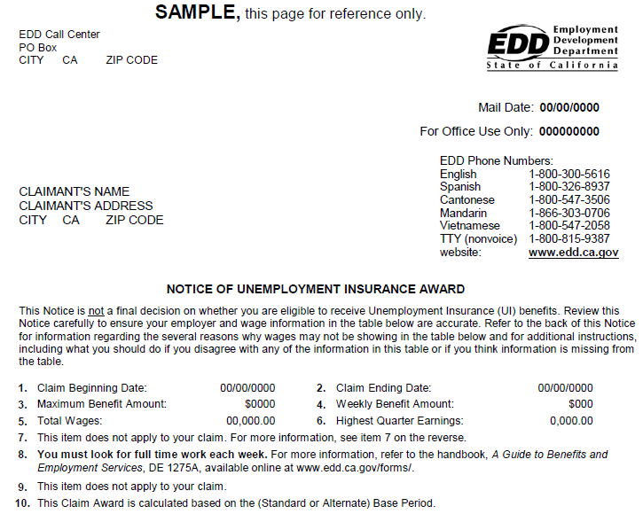
Notes:
This is one piece of information you will receive after you file for unemployment insurance benefits. You will receive this award letter before any determination is made regarding your eligibility so that you can verify the information is accurate and you know what you can potentially receive. If you need additional information refer to the “Unemployment Insurance Benefits: What You Need to Know” (DE 1275B) booklet available online at: www.edd.ca.gov/Unemployment under the “Forms and Publications” link.

Slide 9
How to Certify for Benefits
To receive benefits, you must certify for benefits every two weeks by providing eligibility information to the EDD:
UI Online : edd.ca.gov/UI_Online
  This is the fastest way to certify and get paid. Available 24/7.
  Must register for an account using your EDD Customer Account Number.
    Most customers are automatically registered and receive a confirmation email.
  Automatic email reminders when it’s time to certify.
EDD Tele-CertSM: Call 1-866-333-4606
  Must enter or create a four digit PIN to access the system.
Mail:
  Allow extra time for mail delivery and processing.
Notes:
[READ SLIDE]

Slide 10
Get Paid – Debit Card
A Bank of America Debit Card is mailed once the first payment is made:
  Allow five business days for mail delivery from Bank of America.
    Due to unprecedented volume of claims, the card may take a few extra days to arrive.
  The card is valid for three years from the date of issue and used for Disability Insurance (DI), Paid Family Leave (PFL), and Unemployment Insurance (UI) benefits.
  Contact Bank of America for replacement card (online or phone) and customer service.
  Get cash at ATMs or merchants with cash back options.
  Use the card anywhere Visa is accepted.
  Set up automatic transfers to any financial institution.
  Set alerts whenever a deposit is made or when you have a a low balance.
Notes:
[READ SLIDE]

Slide 11

Get Paid – Debit Card
Dedicated Bank of America customer service available 24/7 at:
  Online: visaprepaidprocessing.com/eddcard
  Phone: 1-866-692-9374
Notes:
[READ SLIDE]

Slide 12
Get Paid – Debit Card
Important:
Do not contact Bank of America EDD Debit Card Customer Service under for questions about your claim.
Additionally, Bank of America branch offices cannot
assist with debit card inquiries except for ATM and teller withdrawals.
Notes:
[READ SLIDE]

Slide 13
Tips to Receive Your Benefits Faster
Certify for benefits using UI Online or EDD Tele-Cert.
  Bookmark the Benefit Programs Online login screen for easy access.
    Set alerts through Bank of America to notify you when an EDD payment posts to your debit card.
Read and respond promptly, if requested, to all EDD communication.
Prepare for possible phone interviews to resolve claim issues.
Access helpful webpages and educational videos on the EDD website.
Notes:
[READ SLIDE]

Slide 14
Get Connected 24/7
EDD website: edd.ca.gov
  Information on all EDD programs.
UI Online: edd.ca.gov/UI_Online
  File a new claim*.
  Certify for benefits.
  Get payment information.
  Ask a question about your claim.
  Update your contact information.
UI Self-Service Phone Line: 1-866-333-4606
  Certify for benefits using EDD Tele-Cert.
  Get payment information for your last payment made.
  Hear general information about the UI program.
  * Some late night and early morning hours are not available due to scheduled maintenance.
Notes:
[READ SLIDE]

Slide 15
Unemployment Insurance Phone Numbers
UI Customer Service: Daily from 8 a.m. to 8 p.m.
  English and Spanish: 1-800-300-5616
  Cantonese: 1-800-547-3506
  Mandarin: 1-866-303-0706
  Vietnamese: 1-800-547-2058
  Deaf and Hard of Hearing: Dial the California Relay Service at 711 and request one of the numbers listed above.
Help with UI Online: 1-833-978-2511. Daily from 8 a.m. to 8 p.m.
UI Self-Service Line: 1-866-333-4606 available 24/7.
Notes:
[READ SLIDE]
TTY: 1-800-815-9387

Slide 16
America’s Job Center of CaliforniaSM
The America's Job Center of California (AJCC) offers a variety of services that bring employers with job openings and qualified job seekers together at no cost.
There are several types of services available at an AJCC:
  Workforce Innovation and Opportunity Act (WIOA).
  Trade Adjustment Assistance (TAA) program information.
Notes:
The America's Job Center of CaliforniaSM (AJCC) offers a comprehensive range of no-cost employment and training services for employers and job seekers.
There are several types of services available at an AJCC:
Workforce Innovation and Opportunity Act (WIOA) funding provides career, training, and supportive services.
the Trade Adjustment Assistance (TAA) program is a federal program that provides training, case management and employment services, job search allowances, relocation allowances, and income support to individuals who have been laid off, or threatened with layoff, due to foreign trade.

Slide 17
America’s Job Center of California
  Career planning.
  Skills assessment.
  Workshops.
  Labor market information.
  Job fairs and other job matching services.
  Marketing workers to area employers.
  Occupational training.
Notes:
The AJCC also provides:
Career planning
Skills assessment
Workshops such as résumé writing and interviewing techniques
Labor market information, which is provided by the Employment Development Department on its website and includes occupational profiles (and projections of employment) for occupations and industries throughout California.
Job fairs and other job matching services
Marketing workers to area employers
Occupational training

Slide 18
America’s Job Center of California
  Special services for veterans and youth.
  Job clubs.
  Employer recruitments.
  Training and other resources.
  CalJOBSSM: caljobs.ca.gov
    Access to thousands of job openings statewide.
    Access 24 hours a day, 7 days a week.
    No fee to use.
Notes:
The AJCC system also offers:
Special Services (if eligibility requirements are met) to Veterans (such as one-on-one desk coaching/career counseling/GI Bill), and Youth through the Youth Employment Opportunity Program for at-risk youth aged 15-25 years old.
Experience Unlimited Job Clubs, which are a Job Search association for professional, technical and managerial
Employer Recruitments- AJCCs host on-site and virtual employer recruitments
AJCCs consider the availability of other resources and grants to pay for training costs such as Temporary Assistance for Needy Families (TANF), State-funded training funds, and Federal Pell Grants, so that WIOA funds supplement other sources of training grants. You can contact your local AJCC for more information on local programs and other community resources.
And, last, but not least, CalJOBS: A no-cost Internet job search system accessible from any computer 24 hours a day, 7 days a week. CalJOBS allows you to tailor and save multiple résumés to submit to employers. Employers can also view your resume based on key words. In addition, CalJOBS searches the internet and sends emails of job listings that match job search objectives. You can access CalJOBSSM at caljobs.ca.gov.
Most UI customers are required to register for CalJOBS and create an online resume that can be viewed by employers. You must meet this requirement within 21 days of receiving your Notice of Requirement to Register for Work (DE 8405) form. Failure to meet this requirement can result in a delay or loss of UI benefits.

Slide 19
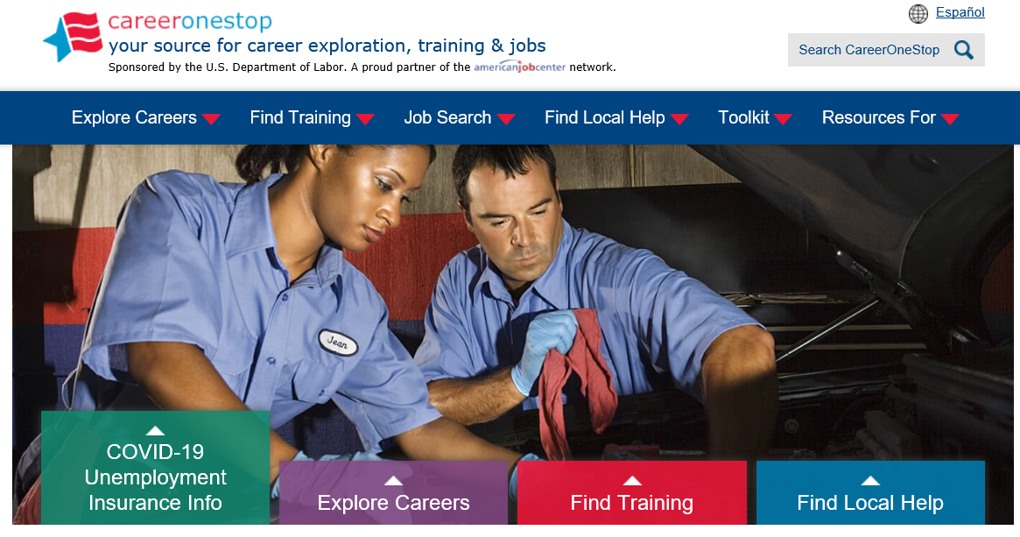
careeronestop.org
Notes:
To connect with your local America’s Job Center of CaliforniaSM, you can visit careeronestop.org. In addition to finding local help, this website is your source for career exploration, training and jobs.
[LOCAL AREAS CAN ADD IN SLIDES FOR THEIR SPECIFIC OFFICES/SERVICES/PROGRAMS/GRANTS AFTER THIS SLIDE]

Slide 20
Labor Market Information Division
The Labor Market Information Division (LMID) regularly collects, analyzes, and publishes information about California’s labor market.
  Also provides economic development and planning information.
Types of information available:
  Occupational profiles and occupation comparisons.
  Projections of employment for occupations and industries by county.
  Growth and decline industries in all counties in California.
Find additional information on the EDD website: labormarketinfo.edd.ca.gov
Notes:
[OPTIONAL = IF LIMITED ON TIME, THIS SLIDE CAN BE SKIPPED]
[READ SLIDE]

Slide 21
State Disability Insurance Program
Disability Insurance (DI) is a partial wage replacement for eligible California workers.
Paid Family Leave.
Cannot collect DI at the same time as UI.
Find additional information on the EDD website: edd.ca.gov/disability
Notes:
[OPTIONAL = IF LIMITED ON TIME, THIS SLIDE CAN BE SKIPPED]
Disability Insurance (DI) is a component of the State Disability Insurance program. It provides partial wage replacement benefits to eligible California workers who are unable to work due to a non-work-related illness, injury, or pregnancy and is funded through employee payroll deduction. Although work-related disabilities are covered by workers’ compensation laws, DI benefits may also be paid for work-related illness or injuries under certain circumstances.
Paid Family Leave (PFL) provides benefits to individuals who need to take time off work to care for a seriously ill child, parent, parent-in-law, grandparent, grandchild, sibling, spouse, or registered domestic partner. Benefits are also available to parents who need time to bond with a new child entering their life either by birth, adoption, or foster care placement.
It is important to note that you cannot collect Disability Insurance at the same time as Unemployment Insurance.
For additional information on Disability Insurance in California, you can access the EDD website: edd.ca.gov/disability

Slide 22
Covered California
No cost service that connects Californians with brand-name health insurance.
Financial help when you buy health insurance from well-known companies.
May qualify for a discount on a health plan or get insurance through Medi-Cal.
Notes:
[OPTIONAL = IF LIMITED ON TIME, THIS SLIDE CAN BE SKIPPED]
Covered California is a no cost service that connects Californians with brand-name health insurance under the Patient Protection and Affordable Care Act.
It’s the only place where you can get financial help when you buy health insurance from well-known companies.
That means when you apply, you may qualify for a discount on a health plan through Covered California, or get health insurance through the state’s Medi-Cal program. Either way, you’ll have great health coverage.

Slide 23
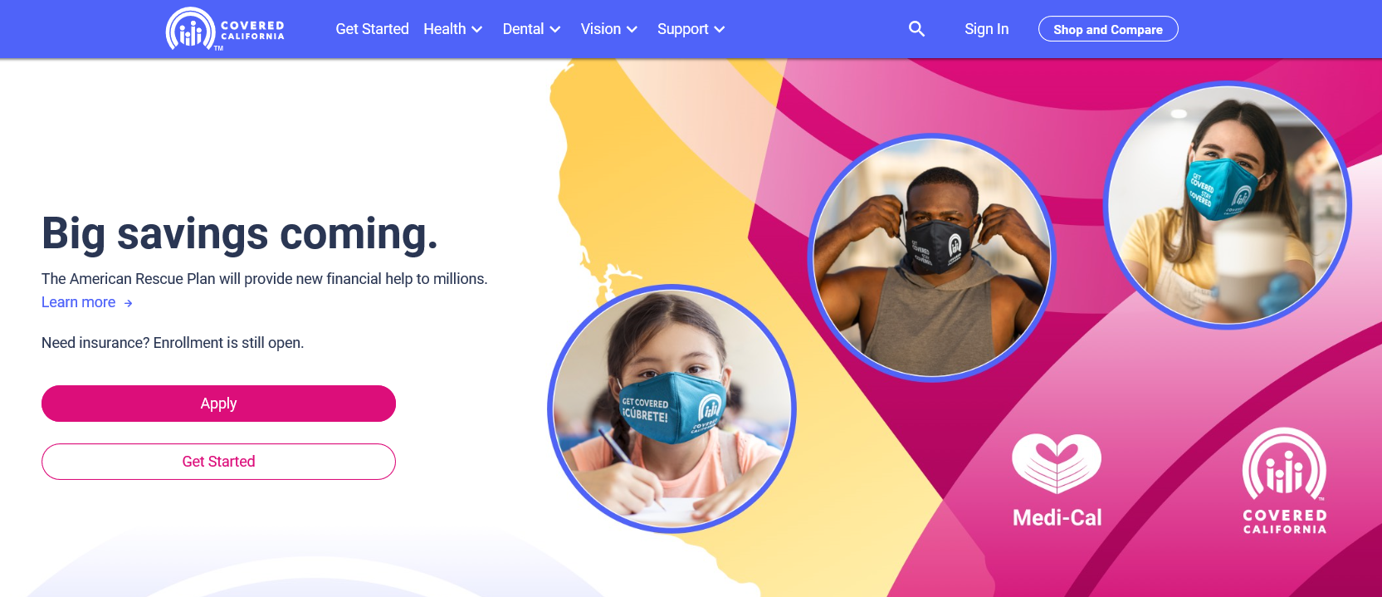
coveredca.com
Notes:
[OPTIONAL = IF LIMITED ON TIME, THIS SLIDE CAN BE SKIPPED]
Additional information can be found on the website: coveredca.com

Slide 24
US Department of Labor
Consolidated Omnibus Budget Reconciliation Act (COBRA).
Health Insurance Portability and Accountability Act (HIPPA).
Employee Retirement Income Security Act (ERISA).
Affordable Care Act (ACA).
Find additional information on the DOL website: dol.gov.
US Department of Labor’s Employment Benefits Security Administration: 1-866-444-3272.
Notes:
[OPTIONAL = IF LIMITED ON TIME, THIS SLIDE CAN BE SKIPPED]
There are several U.S. Department of Labor Resources available to you:
COBRA -The Consolidated Omnibus Budget Reconciliation Act is a federal law that extends your current group health insurance when you experience a qualifying event such as termination of employment or reduction of hours to part-time status.
HIPAA -Health Insurance Portability and Accountability Act provides the ability to transfer and continue health insurance coverage for millions of American workers and their families when they change or lose their jobs
The Employee Retirement Income Security Act is federal law that sets minimum standards for pension plans in private industry
For additional information, access the website at dol.gov
You can also contact the U.S. Department of Labor’s Employment Benefits Security Administration at 1-866-444-3272.

Slide 25
Questions?
Notes:
Thank you for attending todays session. You were presented a lot of information today so:
Don’t waste time – Contact your nearest America’s Job Center of CA to expand your work search.
Make your plan…. Utilize all of the resources mentioned today. We are here to help you.
Take action now!

Slide 26
The EDD is an equal opportunity employer/program. Auxiliary aids and services are available upon request to individuals with disabilities.

