Slide 1
Rapid Response
COVID-19 Services and Resources
Notes:
Revised April 8, 2021

Slide 2
Purpose
Provide information on unemployment benefits and programs.
Discuss employment and training assistance programs.
Connect to other federal, state, and local resources.
Notes:
Rapid Response is a no cost program designed to get you back to work as quickly as possible following a layoff or plant closure. The purpose of this Rapid Response Orientation is to:
Provide information on the unemployment compensation benefits and programs,
Discuss employment and training programs available through the comprehensive one-stop delivery system, and
Connect you to other federal, state, and local resources.
These services and resources are customized to your needs, with the goal of minimizing the disruptions on your life associated with job loss. These services are carried out by state and local workforce development agencies in partnership with the America’s Job Center of CaliforniaSM network.

Slide 3
State of California
Employment Development Department
Employment Development Department (EDD):
  Unemployment Insurance Branch.
  Workforce Services Branch.
  Labor Market Information Division (LMID).
  Disability Insurance Branch.
Notes:
The State of California’s Employment Development Department comprises of several branches and divisions:
The Unemployment Insurance Branch
The Workforce Services Branch
The Labor Market Information Division (LMID), and
The Disability Insurance Branch

Slide 4
Unemployment Insurance Program
Partial income replacement for employees who lost their jobs or had hours reduced due to no fault of their own.
Funded by employers at no cost to employees.
Weekly benefit amounts range from $40 to $450 based on earnings.
Notes:
The Unemployment Insurance benefits program provides:
A partial, temporary income replacement for employees who have lost their jobs or have had their hours reduced due to no fault of their own.
Funded by employers at no cost to employees.
Regular Unemployment Insurance (UI) claim weekly benefit amounts range from $40 to $450 based on previous earnings. When filing for UI benefits, you must have earned enough wages during the base period to establish a claim. The UI base period is a specific 12-month term the EDD uses to see if you earned enough wages to establish a UI claim. The length of your claim depends on your wages.

Slide 5
Federal Provisions for Unemployment
Pandemic Unemployment Assistance (PUA).
  Provides up to 86 weeks of Unemployment Insurance benefits for those who don’t usually qualify for regular claims, such as business owners, the self-employed, and independent contractors.
  PUA is available through September 4, 2021.
Pandemic Emergency Unemployment Compensation (PEUC).
  Up to 53 weeks of extended benefits between March 29 and September 4, 2021.
  Applies only to regular UI claims and is automatically filed for claimants.
Pandemic Additional Compensation.
  Automatically provides an additional $300 federal stimulus payment to each week benefits are received from December 27, 2020 through September 4, 2021.
  Also known as the Federal Pandemic Unemployment Compensation.
Notes:
These are the federal provisions to expand unemployment benefits so that we can help more Californians impacted by COVID-19:
1. Pandemic Unemployment Assistance (PUA).
Provides up to 86 weeks of UI benefits for those who don’t usually qualify for regular claims, such as business owners, the self-employed, and independent contractors. PUA claim can is available through September 4, 2021.
2. Pandemic Emergency Unemployment Compensation (PEUC).
Up to 53 weeks of extended benefits between March 29 and September 4, 2021. Applies only to regular UI claims and is automatically filed for claimants.
3. Pandemic Additional Compensation
Provides an additional $300 federal stimulus payment automatically to each week benefits are received from December 27, 2020 through September 4, 2021. Also known as the Federal Pandemic Unemployment Compensation

Slide 6
Mixed Earner Unemployment Compensation
The EDD is working with the Department of Labor (DOL) for guidance on how to implement the Mixed Earner Unemployment Compensation (MEUC) program.
Applies only to “mix earner” customers who are on a regular UI claim and earned at least $5,000 in self-employment income.
Provides an additional $100 stimulus payment between December 27, 2020 and September 4, 2021.
The MEUC payment is in addition to the $300 stimulus payment which applies during the same time.
Notes:
This is a brand new component to the CARES Act and only applies to mixed earners. A mixed earning is someone who had earned enough W-2 wages to establish a regular UI claim but also earned at least $5,000 in self-employment or independent contractor earnings.
The MEUC provides: [Read BULLETS]

Slide 7
Federal-State Extended Benefits
Authorized when the unemployment rate reaches a certain threshold as determined by federal and state law.
  Began May 10, 2020, and in effect until the unemployment rate drops below the trigger level.
Automatically filed when a claimant has exhausted their PEUC extension and meet eligibility requirements.
Provides up to 20 additional weeks of extended benefits for claimants who have exhausted their regular UI claim and PEUC extension benefits.
  Does not apply to PUA claims.
  Must meet wage and time requirements.
  If not eligible for Federal-State Extended Duration extension, a PUA claim is filed if unemployment is direct result of COVID-19.
  Regular UI benefit weeks plus PUA weeks cannot exceed a total of 46 weeks.
  A temporary measure allows up to 20 weeks of extended benefits.
Notes:
[READ SLIDE]

Slide 8
UI Improvements
UI OnlineSM is still available to certify for benefits, check payment information, reopen an existing claim, and more.
EDD is improving its systems to verify identities, process claims, prevent fraud, and reduce the backlog of claims.
New UI claimants will need to verify their identity through ID.me before they can file a claim online.
Notes:
[READ SLIDE]

Slide 9
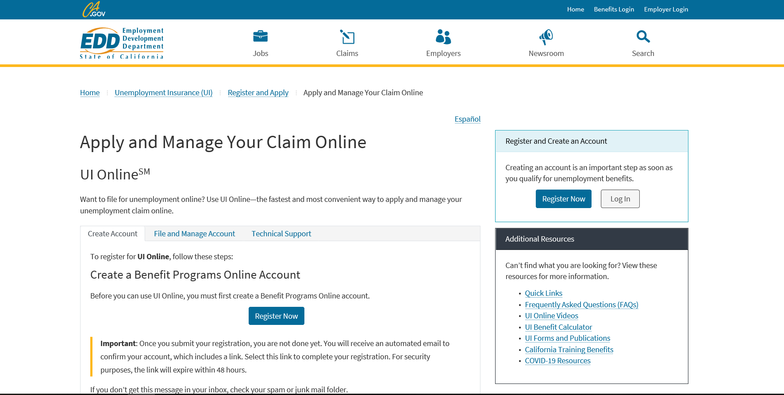
edd.ca.gov/UI_Online
Notes:
To apply for Unemployment insurance claims, you can file online, by phone, fax, or mail.
Online:
UI OnlineSM is the fastest way to file a claim at edd.ca.gov/UI_Online. The system is available 7 days a week, 24 hours a day.

Slide 10
Unemployment Insurance Basics: File a Claim
Online:
  Create a Benefit Programs Online login to access UI Online.
  Claimants may receive a confirmation email within a few days notifying them a UI Online account has been created for them.
  UI Online technical assistance is available daily from 8 a.m. to 8 p.m. to help with registration and password resets.
Phone:
  Speak to a representative to file a claim: 1-800-300-5616
Fax/Mail:
  Complete the paper application and submit as directed on the form.
    Allow additional time for processing.
Notes:
Create a Benefit Programs Online login to access UI Online.
When applying for UI benefits, you will need your Driver License or ID; last employer name and address; dates of employment; name of supervisor
To comply with fraud prevention, you may be asked several security questions when you apply for UI.
Claimants may receive a confirmation email within a few days notifying them that a UI Online account has been created for them.
UI OnlineSM technical assistance is available daily from 8 a.m. to 8 p.m. to help with registration and password resets.
Phone:
When calling to file your claim, you can expect extreme wait times. The phone lines are only available to talk to a representative on Monday through Friday 8 AM – 8 PM.
Fax/Mail:
Provide all required information to avoid processing delays.
Complete the paper application and submit as directed on the form. The application can be found at edd.ca.gov/unemployment/Filing_a_Claim.htm. Allow additional time for processing, especially with mail delivery
Tips for Filing a Claim:
Gather your employment information for the past 18 months.
Apply through UI OnlineSM for the fastest processing.
Use the Save as Draft feature if you need more time to complete the online application; you have until 8 p.m. on Saturday.
Indicate if you’re out of work due to COVID-19.
When selecting your industry and occupation, select the one that best describes your job.
Do not indicate you’re out of work due to a strike or lockout unless it’s a result of a labor union dispute over working conditions.
See our YouTube video, How to Apply for UI Benefits (File a Claim).

Slide 11
After a Claim is Filed
Important information you will receive from the EDD by mail:
  Confirmation that your claim was filed.
  How your weekly benefit amount was computed.
  Your EDD Customer Account Number used to create your UI OnlineSM account.
Verify accuracy of your claim and wage information and notify the EDD immediately if the information incorrect.
Continue to read, review, and respond to all communication.
Notes:
[READ SLIDE]

Slide 12
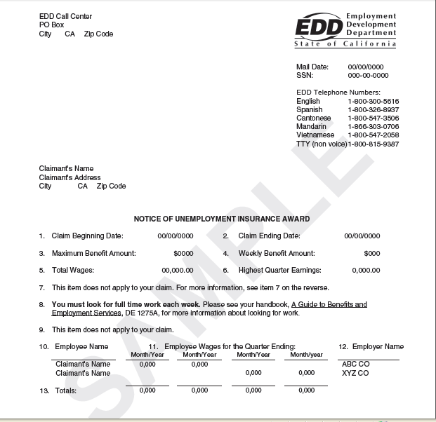
Notes:
This is one piece of information you will receive after you file for unemployment insurance benefits. You will receive this award letter before any determination is made regarding your eligibility so that you can verify the information is accurate and you know what you can potentially receive. If you need additional information refer to the “Unemployment Insurance Benefits: What You Need to Know” (DE 1275B) booklet available online at: www.edd.ca.gov/Unemployment under the “Forms and Publications” link.

Slide 13
How to Certify for Benefits
To receive benefits, you must certify for benefits every two weeks by providing eligibility information to the EDD:
UI OnlineSM and UI Online MobileSM: edd.ca.gov/UI_Online
  This is the fastest way to certify and get paid. Available 24/7.
  Must register for an account using your EDD Customer Account Number.
    Most customers are automatically registered and receive a confirmation email.
  Automatic email reminders when it’s time to certify.
EDD Tele-CertSM: Call 1-866-333-4606
  Must enter or create a four digit PIN to access the system.
Mail:
  Allow extra time for mail delivery and processing.
Important: Report wages using Ask EDD.
Notes:
[READ SLIDE]

Slide 14
Get Paid – EDD Debit CardSM
An EDD Debit CardSM is mailed once the first payment is made:
  Allow five business days for mail delivery from Bank of America.
    Due to unprecedented volume of claims, the card may take a few extra days to arrive.
  The card is valid for three years from the date of issue and used for Disability Insurance (DI), Paid Family Leave (PFL), and Unemployment Insurance (UI) benefits.
  Contact Bank of America for replacement card (online/phone) and customer service.
  Get cash at ATMs or merchants with cash back options.
  Use the card anywhere Visa is accepted.
  Set up automatic transfers to any financial institution.
  Set alerts whenever a deposit is made or when you have a a low balance.
Notes:
[READ SLIDE]

Slide 15

Get Paid – EDD Debit CardSM
Dedicated Bank of America customer service available 24/7 at:
  Online: bankofamerica.com/eddcard
  Phone: 1-866-692-9374
Notes:
[READ SLIDE]

Slide 16
Get Paid – EDD Debit CardSM
Important:
Do not contact Bank of America EDD Debit Card Customer Service under for questions about your claim.
Additionally, Bank of America branch offices cannot
assist with debit card inquiries except for ATM and teller withdrawals.
Notes:
[READ SLIDE]

Slide 17
Tips to Receive Your Benefits Faster
Certify for benefits using UI OnlineSM, UI Online MobileSM, or EDD Tele-CertSM.
  Bookmark the Benefit Programs Online login screen for easy access.
    Set alerts through Bank of America to notify you when an EDD payment posts to your debit card.
Read and respond promptly, if requested, to all EDD communication.
Prepare for possible phone interviews to resolve claim issues.
Access helpful webpages and educational videos on the EDD website.
Stay well-informed by checking the EDD’s COVID-19 webpage for updates and frequently asked questions: edd.ca.gov/about_edd/coronavirus-2019.htm
Notes:
[READ SLIDE]

Slide 18
Get Connected 24/7
EDD website: edd.ca.gov
  Information on all EDD programs.
  Latest COVID-19 news.
UI OnlineSM and UI Online MobileSM: edd.ca.gov/UI_Online
  File a new claim*.
  Certify for benefits.
  Get payment information.
  Ask a question about your claim.
  Update your contact information.
UI Self-Service Phone Line: 1-866-333-4606
  Certify for benefits using EDD Tele-CertSM.
  Get payment information for your last payment made.
  Hear general information about the UI program.
  * Some late night and early morning hours are not available due to scheduled maintenance.

Slide 19
Unemployment Insurance Phone Numbers
Regular UI and PUA claims: Daily from 8 a.m. to 8 p.m.
  English and Spanish: 1-800-300-5616
  Cantonese: 1-800-547-3506
  Mandarin: 1-866-303-0706
  Vietnamese: 1-800-547-2058
  Deaf and Hard of Hearing: Dial the California Relay Service at 711 and request one of the numbers listed above.
Help with UI OnlineSM: 1-833-978-2511. Daily from 8 a.m. to 8 p.m.
UI Self-Service Line: 1-866-333-4606 available 24/7.
Notes:
[READ SLIDE]
TTY: 1-800-815-9387

Slide 20
America’s Job Center of CaliforniaSM
The America's Job Center of CaliforniaSM (AJCC) offers a variety of services that bring employers with job openings and qualified job seekers together at no cost.
To prevent the spread of COVID-19, AJCC services are available by appointment only.
Services provided through appointment:
  Workforce Innovation and Opportunity Act (WIOA).
  Trade Adjustment Assistance (TAA) program information.
Notes:
The America's Job Center of CaliforniaSM (AJCC) offers a comprehensive range of no-cost employment and training services for employers and job seekers.
The AJCC normally provides services in-person, however, to prevent the spread of COVID-19, AJCC services are available by appointment only at many locations. Only some AJCCs are open to the public. Contact your local AJCC to ask about scheduling an appointment.
There are several types of services available at an AJCC:
Workforce Innovation and Opportunity Act (WIOA) funding provides career, training, and supportive services.
the Trade Adjustment Assistance (TAA) program is a federal program that provides training, case management and employment services, job search allowances, relocation allowances, and income support to individuals who have been laid off, or threatened with layoff, due to foreign trade.

Slide 21
America’s Job Center of CaliforniaSM
  Career planning.
  Skills assessment.
  Workshops.
  Labor market information.
  Job fairs and other job matching services.
  Marketing workers to area employers.
  Occupational training.
Notes:
The AJCC also provides:
Career planning
Skills assessment
Workshops such as résumé writing and interviewing techniques
Labor market information, which is provided by the Employment Development Department on its website and includes occupational profiles (and projections of employment) for occupations and industries throughout California.
Job fairs and other job matching services
Marketing workers to area employers
Occupational training

Slide 22
America’s Job Center of CaliforniaSM
  Special services for veterans and youth.
  Job clubs.
  Employer recruitments.
  Training and other resources.
  CalJOBSSM: caljobs.ca.gov
    Access to thousands of job openings statewide.
    Access 24 hours a day, 7 days a week.
    No fee to use.
Notes:
The AJCC system also offers:
Special Services (if eligibility requirements are met) to Veterans (such as one-on-one desk coaching/career counseling/GI Bill), and Youth through the Youth Employment Opportunity Program for at-risk youth aged 15-25 years old.
Experience Unlimited Job Clubs, which are a Job Search association for professional, technical and managerial
Employer Recruitments- AJCCs host on-site and virtual employer recruitments
AJCCs consider the availability of other resources and grants to pay for training costs such as Temporary Assistance for Needy Families (TANF), State-funded training funds, and Federal Pell Grants, so that WIOA funds supplement other sources of training grants. You can contact your local AJCC for more information on local programs and other community resources.
And, last, but not least, CalJOBS: A no-cost Internet job search system accessible from any computer 24 hours a day, 7 days a week. CalJOBS allows you to tailor and save multiple résumés to submit to employers. Employers can also view your resume based on key words. In addition, CalJOBS searches the internet and sends emails of job listings that match job search objectives. You can access CalJOBSSM at caljobs.ca.gov.
Most UI customers are required to register for CalJOBS and create an online resume that can be viewed by employers. You must meet this requirement within 21 days of receiving your Notice of Requirement to Register for Work (DE 8405) form. Failure to meet this requirement can result in a delay or loss of UI benefits.

Slide 23
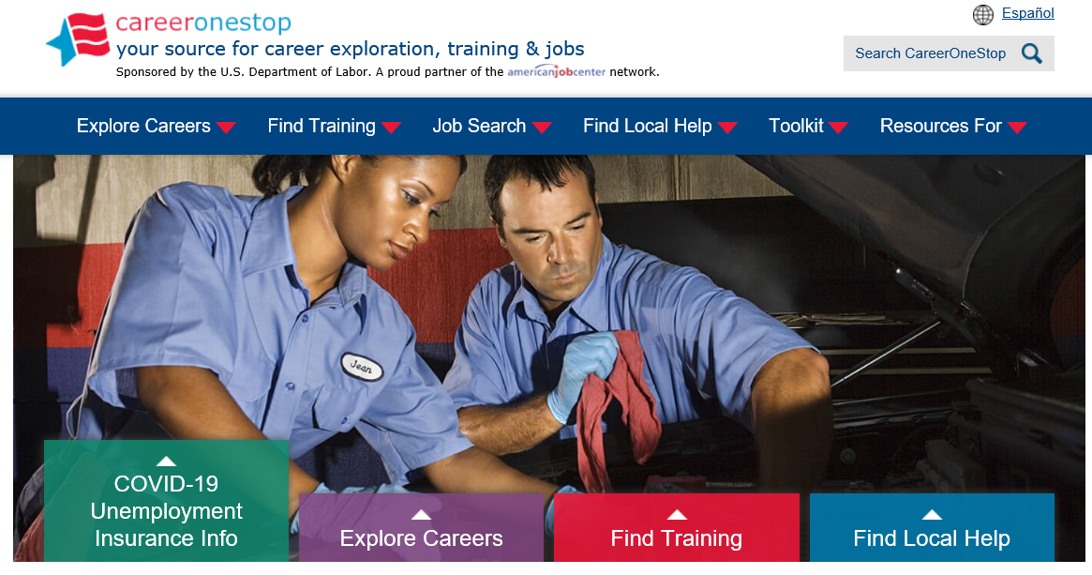
careeronestop.org
Notes:
To connect with your local America’s Job Center of CaliforniaSM, you can visit careeronestop.org. In addition to finding local help, this website is your source for career exploration, training and jobs.
[LOCAL AREAS CAN ADD IN SLIDES FOR THEIR SPECIFIC OFFICES/SERVICES/PROGRAMS/GRANTS AFTER THIS SLIDE]

Slide 24
Labor Market Information Division
The Labor Market Information Division (LMID) regularly collects, analyzes, and publishes information about California’s labor market. It also provides economic development and planning information.
Types of information available :
  Occupational profiles and occupation comparisons.
  Projections of employment for occupations and industries by county.
  Growth and decline industries in all counties in California.
Find additional information on the EDD website: labormarketinfo.edd.ca.gov
Notes:
[OPTIONAL = IF LIMITED ON TIME, THIS SLIDE CAN BE SKIPPED]
[READ SLIDE]

Slide 25
State Disability Insurance Program
Disability Insurance (DI) is a partial wage replacement for eligible California workers.
Paid Family Leave.
Cannot collect DI at the same time as UI.
Find additional information on the EDD website: edd.ca.gov/disability
Notes:
[OPTIONAL = IF LIMITED ON TIME, THIS SLIDE CAN BE SKIPPED]
Disability Insurance (DI) is a component of the State Disability Insurance program. It provides partial wage replacement benefits to eligible California workers who are unable to work due to a non-work-related illness, injury, or pregnancy and is funded through employee payroll deduction. Although work-related disabilities are covered by workers’ compensation laws, DI benefits may also be paid for work-related illness or injuries under certain circumstances.
Paid Family Leave (PFL) provides benefits to individuals who need to take time off work to care for a seriously ill child, parent, parent-in-law, grandparent, grandchild, sibling, spouse, or registered domestic partner. Benefits are also available to parents who need time to bond with a new child entering their life either by birth, adoption, or foster care placement.
It is important to note that you cannot collect Disability Insurance at the same time as Unemployment Insurance.
For additional information on Disability Insurance in California, you can access the EDD website: edd.ca.gov/disability

Slide 26
Covered California
If your job was affected by COVID-19, or if you lack income because your hours were cut or if you're no longer working, Covered California is here for you.
No cost service that connects Californians with brand-name health insurance.
Financial help when you buy health insurance from well-known companies.
May qualify for a discount on a health plan or get insurance through Medi-Cal.
Notes:
[OPTIONAL = IF LIMITED ON TIME, THIS SLIDE CAN BE SKIPPED]
Covered California is a no cost service that connects Californians with brand-name health insurance under the Patient Protection and Affordable Care Act.
It’s the only place where you can get financial help when you buy health insurance from well-known companies.
That means when you apply, you may qualify for a discount on a health plan through Covered California, or get health insurance through the state’s Medi-Cal program. Either way, you’ll have great health coverage.

Slide 27
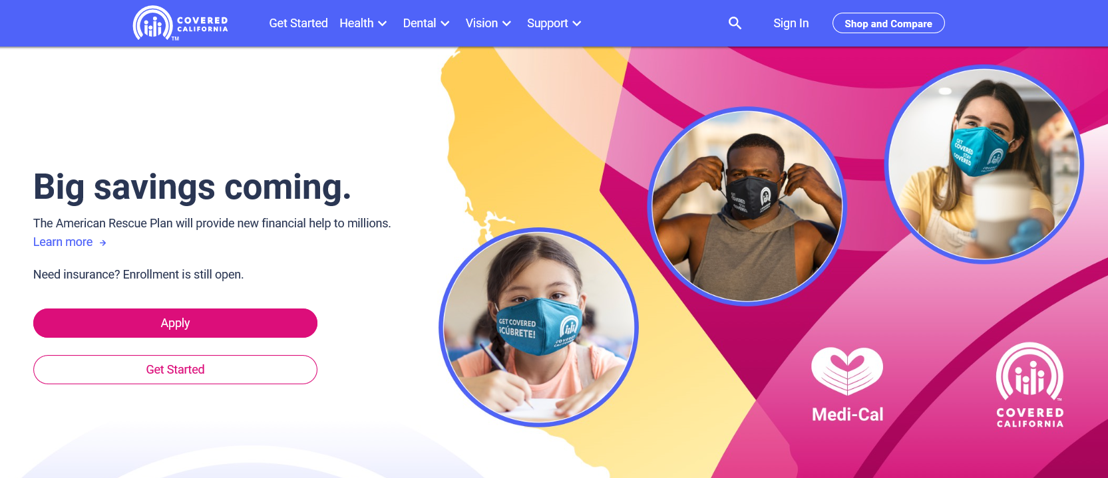
coveredca.com
Notes:
[OPTIONAL = IF LIMITED ON TIME, THIS SLIDE CAN BE SKIPPED]
Additional information can be found on the website: coveredca.com

Slide 28
US Department of Labor
Consolidated Omnibus Budget Reconciliation Act (COBRA).
Health Insurance Portability and Accountability Act (HIPPA).
Employee Retirement Income Security Act (ERISA).
Affordable Care Act (ACA).
Find additional information on the DOL website: dol.gov.
US Department of Labor’s Employment Benefits Security Administration: 1-866-444-3272.
Notes:
[OPTIONAL = IF LIMITED ON TIME, THIS SLIDE CAN BE SKIPPED]
There are several U.S. Department of Labor Resources available to you:
COBRA -The Consolidated Omnibus Budget Reconciliation Act is a federal law that extends your current group health insurance when you experience a qualifying event such as termination of employment or reduction of hours to part-time status.
HIPAA -Health Insurance Portability and Accountability Act provides the ability to transfer and continue health insurance coverage for millions of American workers and their families when they change or lose their jobs
The Employee Retirement Income Security Act is federal law that sets minimum standards for pension plans in private industry
For additional information, access the website at dol.gov
You can also contact the U.S. Department of Labor’s Employment Benefits Security Administration at 1-866-444-3272.

Slide 29
Questions?
Notes:
Thank you for attending todays session. You were presented a lot of information today so:
Don’t waste time – Contact your nearest America’s Job Center of CA to expand your work search.
Make your plan…. Utilize all of the resources mentioned today. We are here to help you.
Take action now!

Slide 30
The EDD is an equal opportunity employer/program. Auxiliary aids and services are available upon request to individuals with disabilities.

